Slide 1
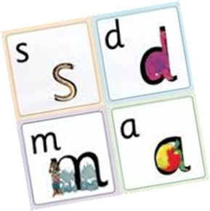
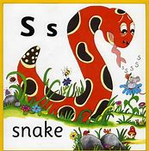
Phonics at Sacred Heart

Slide 2
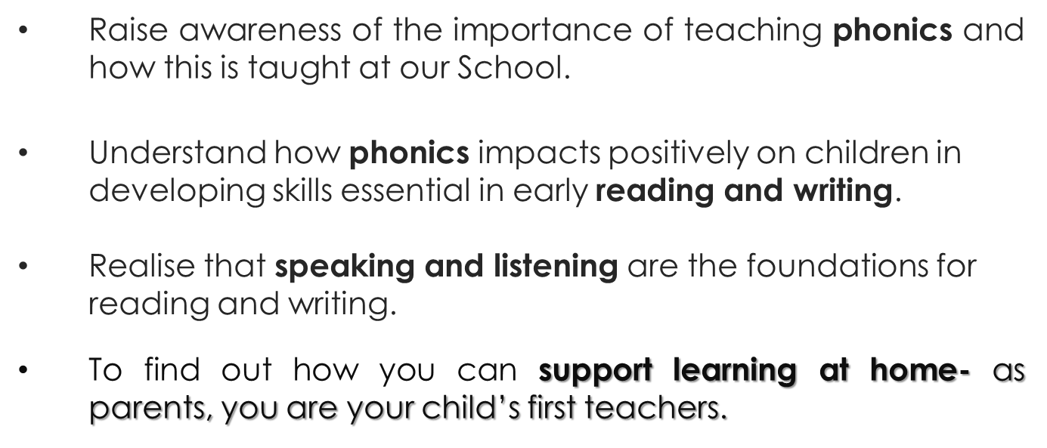
Aims of the session:

Slide 3
JollyPhonics
- see scheme online
- model initial sound lesson ‘a’
- sound, not letter
- each sound had a corresponding picture and song
- hear, say, read, write
Notes:
Sounds linked to pictures
Rhyme how to write- simple & easy for adult and child
Set 1 is taught by december, alphabet plus th, ch, sh.
We don’t teach letter names until summer term/year 1. Capital letters.
In weekly emails the sounds are sent home-print off and use as resource at home so consistent.

Slide 4
Clear, concise, sharp, short
http://www.youtube.com/watch?v=h8m6YFr0gig
Using these sounds in a context (writing video)
Notes:
Explain powerpoint will be sent out to help with pronunciation of sounds
Pascal to give model ‘s’ lesson
Each sound has a corresponding picture for reading and writing.

Slide 5


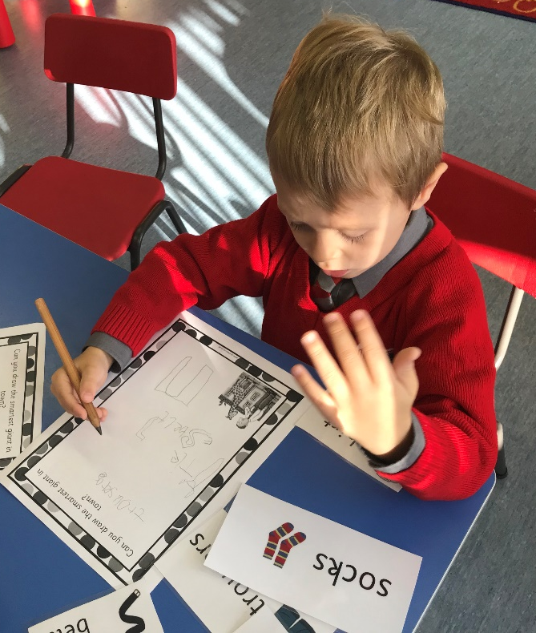
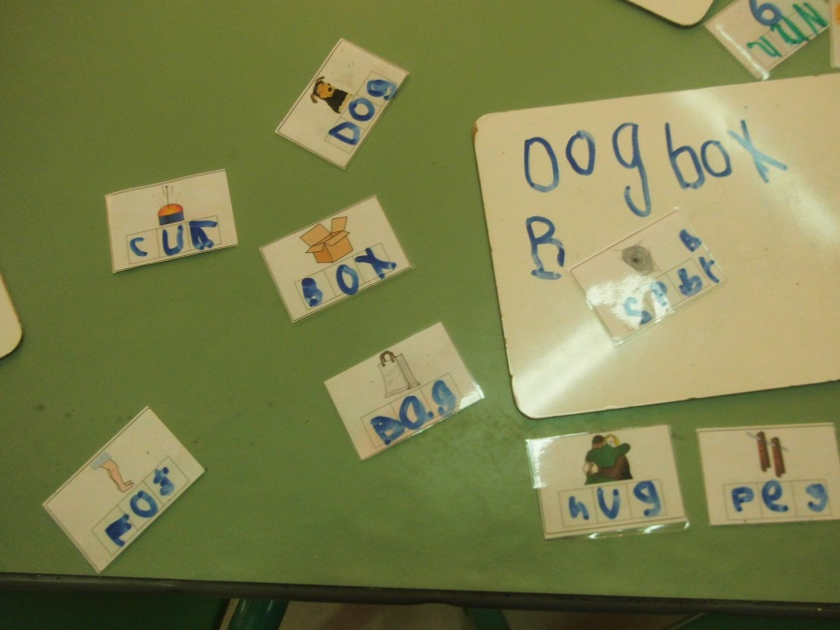
Phonics is….
+
Notes:
Throw the alphabet out the window
See phonics apron
Sounds are sent home- worth making own sets.
We begin blending after the first 5 sounds have been taught- a range of words available.

Slide 6
S a t p i n sat in pin mat at nap it is a m o g c k d not cot kip man mad mat sad tom top pit pot cat can

Slide 7
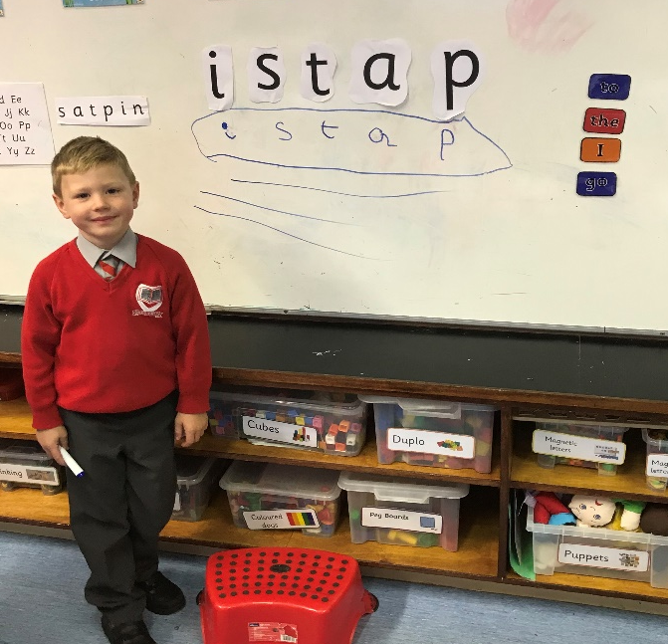
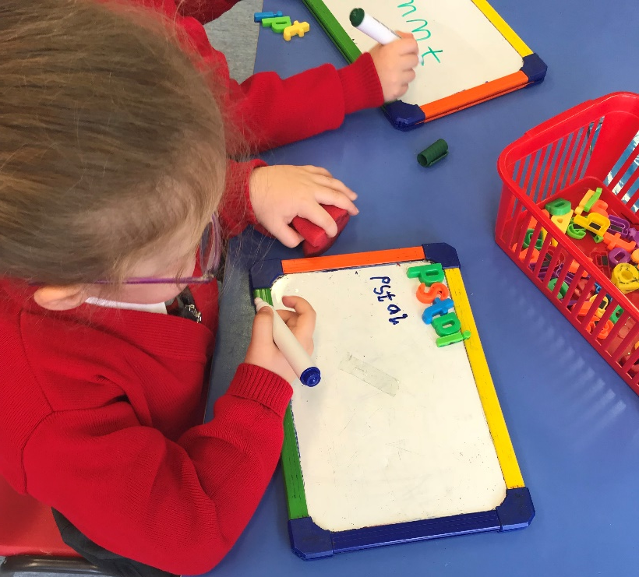

Learn to read and write simple VC, CVC, CVCC words (i.e. at, cat, lamp)

Slide 8
Tricky words
Learn and spell tricky words- word books
Repetition
The to I no go he she we me be my they was said there were Mr Mrs little about like

Slide 9
Example lesson
Set 1 blending
Fred frog
‘m a t ‘
Develops from there into short sentences, ‘a red cat, ‘ a top cat, ‘ sit on the mat’.
Notes:
Laura’s lesson example
Upward spiral- from this, simple sentences will be the next step, then the understanding of simple books.

Slide 10
Opportunity to look at phonics activities that take place in early years
Notes:
Magnetic letters, fishing game, formation mats, formation trays, ipads, blending games, matching sounds to objects, short sentences
Caterpillar games, use scarves, paintbrushes/pe equipment for formation, coloured balls-choose and say a sound

Slide 11
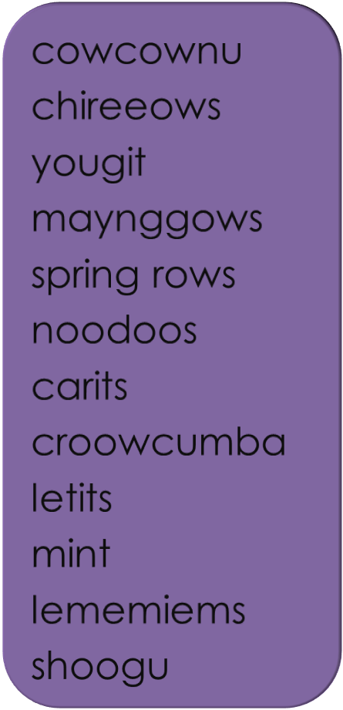
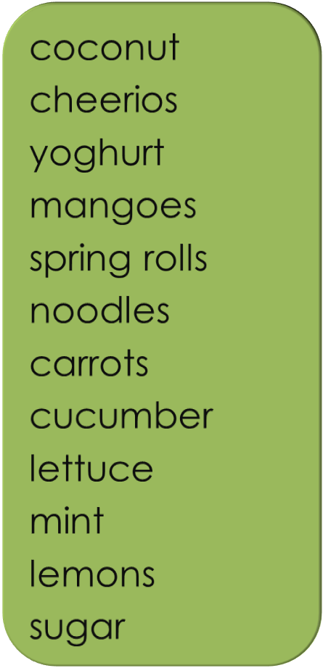
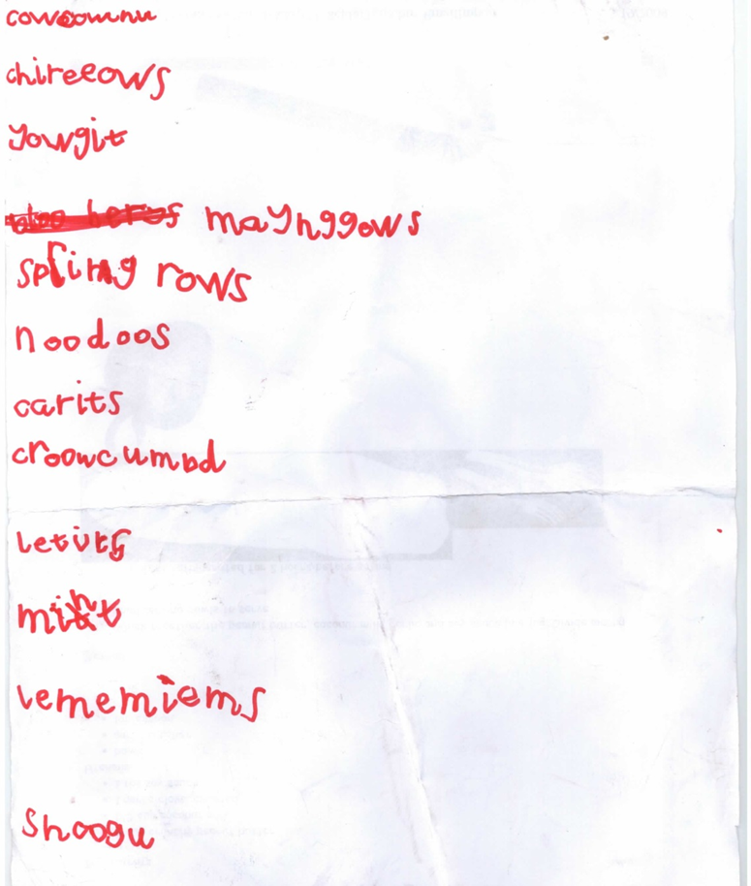
Applying Phonic Knowledge
Notes:
Give easier example …. NOZ. Then give example of tree, or light
These kind of words will fall into place when all sounds have been taught
Don’t discourage- using phonic knowledge
Completely phonically accurate

Slide 12

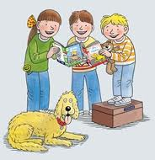
Reading
Schemes:
Oxford Reading Tree, Bug Club
A mix of fiction & Non Fiction
Automatic reading of
de-codable and tricky words is the ultimate goal!!
Notes:
When the child is ready- picture or words.
Reading passport
Encourage to read every night
Tricky words
Combination of tricky words and blending
Comprehension- ask questions when the child has read a sentence to test understanding
Value of the library book- not expected to read but to use the pictures as clues and find sounds they know in sentences.

Slide 13
Practising at home
Short, simple, quick bursts (SNAPPY & HAPPY)
Repetition
Fun activities to apply their knowledge- Included in sand, water, creative. (See weekly education city, homeworks, word books)
Role reverse- Child as teacher
Don’t force phonics- we want the children to enjoy learning.
Necessary praising
Notes:
Practising at home
Give examples of activities
Take apron with sound cards to show example of role reverse
Give examples of praising- don’t overdo
Know where your child is and pitch to their level

Slide 14
Phonics and ICT
List of APPS List of websites
Hairy letters http://www.ictgames.com/writingRepeater/
ABC fun http://www.ictgames.com/dinosaurEggs_phonics
Bob’s book http://www.doorwayonline.org.uk/letterformation.html
My first words Oxford Owl (need to sign up-reading books online)
Sentences http://www.ictgames.com/highFreq/
Squiggles Alphablocks
123 writing http://www.starfall.com/
Teach me words http://www.education.com/games/tutu-blending-sounds-quiz/
Reader
Storykit

Slide 15
Cross Curricular
It is important to remember to link Phonics to every Area of Learning and to challenge children during their play based learning. This will give the children every opportunity to explore and learn in a fun way and will motivated the child to want to learn and share their experiences.
Lists of what we need in our class
Messages/notebooks for friends/teacher
Reading instructions in class
Tricky word password on door
Construction drawing labelling and explanations
Roleplays- lists for a kings castle, shopping lists, invitations
Maths sets of instructions- how to write your numbers, how to be a good adder…
Small world writing templates, reading challenge cards
Labels and stimulus all around the classroom
Investigation area question cards and drawing and writing about what you find (UTW)

Slide 16
Remember…..
Children develop and learn at their own pace with appropriate support and challenge to meet their needs.
Each child is unique.☺

