Slide 1

Primary 3 & 4
Curriculum Outline
Sacred Heart Primary School
Tuesday 12th September

Slide 2

Numeracy
Place Value
Numbers to 100 then 1000
Counting on and counting back
Estimating
Rounding/adjusting
Ordering
Addition/Subtraction
2-3 digit numbers
Linking addition with subtraction
With and without bridging
With partitioning
Multiplication
Table facts
2 digit numbers by 2 & 10
Division
Dividing 2,3,5,10
linking multiplication with division
2 digit numbers beyond tables

Slide 3

Fractions
Mixed numbers
Equivalence
halves, quarters, tenths, thirds, fifths
Decimals
Notation for tenths, units and tenths
ordering
Number Properties
Multiples 0f 2,3,4,5,and 10
Negative numbers e.g temperatures
Area
Squared and half squared centimetres
Non-standard units

Slide 4
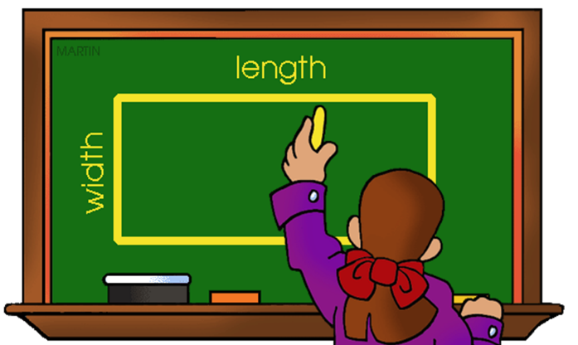
Volume/Capacity
measuring, reading, estimating
Time
Calendar dates
Durations
Writing times
Timetables
Length
Metres and centimetres
Fractions of length
Perimeter
Weight
Grams, kilograms
Reading scales

Slide 5
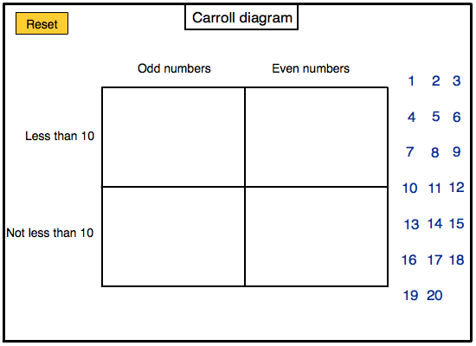
2D Shape
Line symmetry,
Property of shape
triangles
3D Shape
Identifying shapes, faces, vertices and edges
Constructing shapes
Position/Movement/Angles/Co-ordinates
Grid references and co-ordinates
8 point compass
Clockwise and anti-clockwise turns
Data Handling
Tally charts
Bar charts and pictograms
Carroll and Venn diagrams

Slide 6

Literacy
Grammar
Nouns, verbs, adjectives, adverbs, pronouns, prepositions
Prefixes and suffixes
Syllables
Compound words, contractions
Direct and indirect speech
Punctuation – capital letters, full stops, commas, question marks, exclamation marks, apostrophes, speech marks.
Conjunctions
Similes and metaphors
Homophones, antonyms, synonyms
Apostrophes – contractions and possession
Tenses- past, present and future

Slide 7
Text
Reading for comprehension
Analyse / Compare texts
Investigate characters
Develop active attitude towards reading
Prediction, sequencing, anticipating events
Evaluate
Similarities and differences
Writing
Poetry
Fiction and non-fiction exposure to texts
Newspaper reports
Recount, report, instructional, discussion, explanation and persuasive writing
Diaries
Letters

Slide 8
World Around Us
(History, Geography, Science and Technology)
Topics of Study:
My school and the Local Area
Wonderful weather
Toys
UEFA Euro 2020
Through the contributory elements of History, Geography and Science and Technology, pupils should develop knowledge, understanding and skills in:
Interdependence
Pupils should be enabled to explore:
How they and others interact in the world;
How living things rely on each other within the natural world;
Interdependence of people and the environment and how this has been accelerated over time by advances in transport and communications;
The effect of people on the natural and built environment over time.

Slide 9
Place
Pupils will explore:
How place influences the nature of life;
Ways in which people, plants and animals depend on the features and materials in places and how they adapt to their environment;
Features of, and variations in places, including physical, human, climatic, vegetation and animal life;
Our place in the universe;
Change over time in places;
Positive and negative effects of natural and human events upon place over time.
Movement and Energy
Pupils will explore:
The causes and effect of energy, forces and movement;
Causes that effect the movement of people and animals;
How movement can be accelerated by human and natural events such as wars, earthquakes, famine or floods;
Positive and negative consequences of movement and its impact on people, places and interdependence.
Change over Time
Pupils will explore:
How change is a feature of the human and natural world and may have consequences for our lives and the world around us;
Ways in which change occurs over both short and long periods of time in the physical and natural world;
The effects of positive and negative changes globally and how we contribute to some of these changes.

Slide 10

PE
Tuesdays and Thursdays (Gaelic Football and Swimming).
Pupils encouraged to wear their PE uniform into school.
Please encourage your child to attend all lessons.

Slide 11
Homework
40min – 1hr Per Night
To include regular practice of spelling and tables and usually a written Literacy or Numeracy activity.
Please sign written activity.
Activities also from Literacy Bug Club and Education City.
Wednesday night ICT emphasis.
Check homework diary regularly.

Slide 12
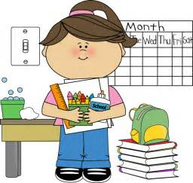
Presentation
Emphasis on neat and tidy presentation.

Slide 13
Ability Grouping
Children will be placed in ability groups.
Work will be differentiated and tailored to their ability.
Naturally, ability groupings will change throughout the year.
Children will be grouped using assessment data, teacher judgment and their ability to complete tasks independently.

Slide 14
Healthy Breaks
Ensure your child has a healthy snack and a bottle of water with them daily.
There will be visits from the Diary Council and sporting agencies throughout the year outlining the benefits of a balanced diet.

Slide 15
Positive Behavior
Classroom rules and guidelines are in place. Remind your child the importance of positive behaviour at all times.
Sanctions may include – verbal reprimand, loss of playtime, loss of points, extra homework and contact with parent.

Slide 16
Rewards
Positive comments/ Praise
County of the week – Homework Pass/ prize
Pupil of the Week - certificate + sticker
Pupil of the Month- certificate + cinema pass
Designed to engage pupils in their learning and promote endeavor.

Slide 17
Absences/Punctuality
v
Short Term Absence- Send in a note which gives a brief explanation.
Long Term Absence- ensure the school is aware. If appropriate work will be sent home.
Repeated Absences/ Punctuality flagged up by EWO.
Punctuality very important as lessons begin at 9.10am.

Slide 18
Independence
An emphasis on pupil independence and organisation.
Please strive to ensure your child is as independent as possible.

Slide 19
Miscellaneous
Homework should be checked and signed. Children should spend approx. 40min-1hr per evening on homework activities.
Check Homework Diary regularly.
Times Tables should be continually practiced. They are very important and link to all aspects of numeracy.
PE Uniform/ Full School Uniform on specific days.
Punctuality very important as lessons begin at 9.10am.
Absence Notes are required. Repeated absences without notes will be flagged up to EWO.
Classroom rules and guidelines are in place. Remind your child the importance of positive behaviour at all times.
Ensure your child has healthy break daily and a bottle of water.
Remind your child the importance of age appropriate personal hygiene.
Reading to be practiced with an adult regularly along with Times Tables.
Help your child to be as independent as possible.
Any queries, contact Carmel to make an appointment.

Slide 20
Communication
Write a note in homework diary
Open door policy for quick queries
Make an appointment with Carmel

Slide 21
Website
Please view the website regularly to view important school updates and to gain an insight into your child’s educational experiences.
www.sacredheartdundrum.co.uk

